Slide 1


“EviWare” (Inspection and Evidence control system)
Department of Information Technology
Chandubhai S. Patel Institute of Technology
PREPARED BY: GUIDED BY: PROF. PINAL SHAH
15IT073(ASHA PATEL)
IT407- SOFTWARE PROJECT MAJOR

Slide 2
OUTLINE:
Presentation:1
Industry details
Problem Identification .
Project description
Project features
Implementation Environment
Presentation:2
User Interface for assign module.
References

Slide 3
INDUSTY DETAILS
Name | Promact Infotech Ltd.
City | Vadodara
Address | B-301 Monalisa business center, Near more mega store, Manjalpur, Vadodara, Gujarat, 390011
Contact No | Office-099250 36216
Email | https://promactinfo.com

Slide 4
PROBLEM IDENTIFICATION
It is possible to have multiple users or task tracker in a particular job.
To maintain the flow of entities, inspection, and evidence, everyone will have to manage it manually by maintaining physical documentation of each and every process.
Most of the time it would be very difficult to do paperwork if tasks or documents are too large with respect to code, time or complexity.
One will require the single platform which helps the users to perform and manage complex task or evidence without doing any manual work.

Slide 5
PROJECT DESCRIPTION
This system is Web based that will manage personal documents and business related financial documents on a single platform without having any manual paper work.
It manages Supply chain management from source to destination with proper flow of goods by providing quality assurance and quality control.
This centralized platform will use different algorithms to verify proper quality and quantity of goods.
This makes it easy to follow product and process chain of supply by simply reviewing reports which answer who, what, where and when for every element you see.

Slide 6
PROJECT FEATURES
System will provide different features to the use to fulfill the requirements.
General features are…
DASHBOARD
PROFILE
CONTACTS
MY DOCUMENTS

Slide 7
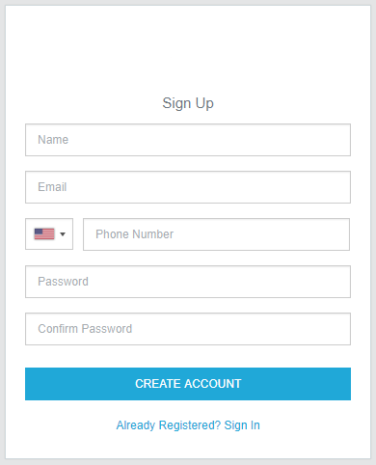
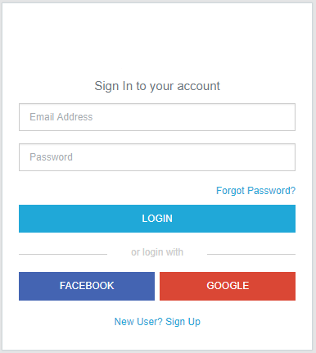
SNAPSHOTS

Slide 8
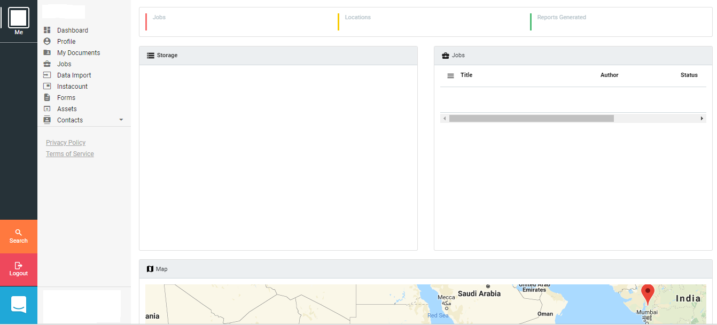
MAIN PAGE & DASHBOARD

Slide 9
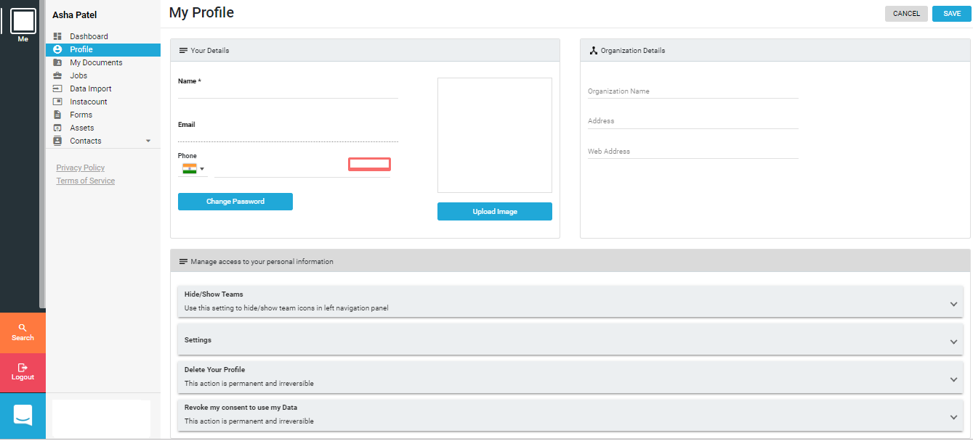
PROFILE

Slide 10
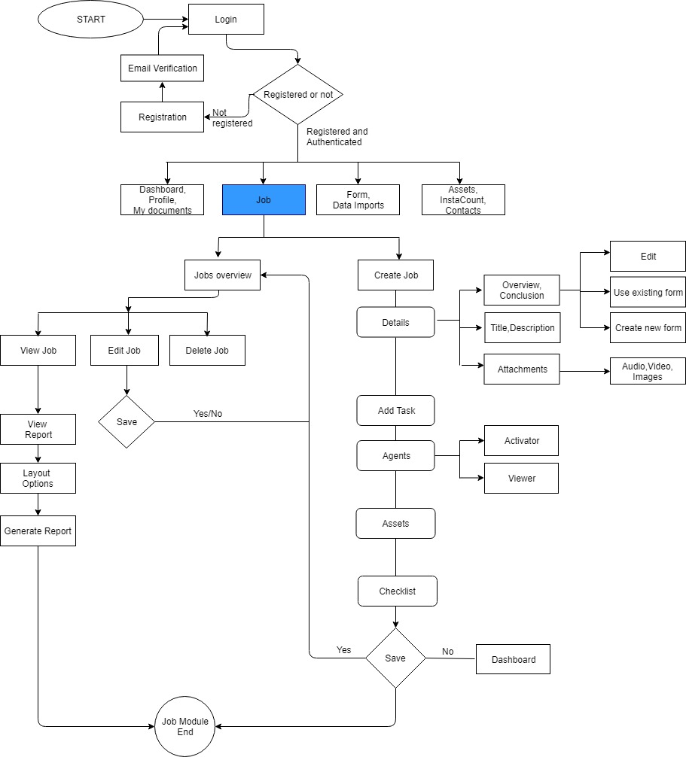
MODULE FLOW

Slide 11
IMPLEMENTATION ENVIRONMENT
Frontend:
Angular 6, HTML, CSS, JavaScript
Backend:
Asp.net Core
Database:
PostgreSQL
Software:
Visual Studio Code/Visual Studio 2017

Slide 12
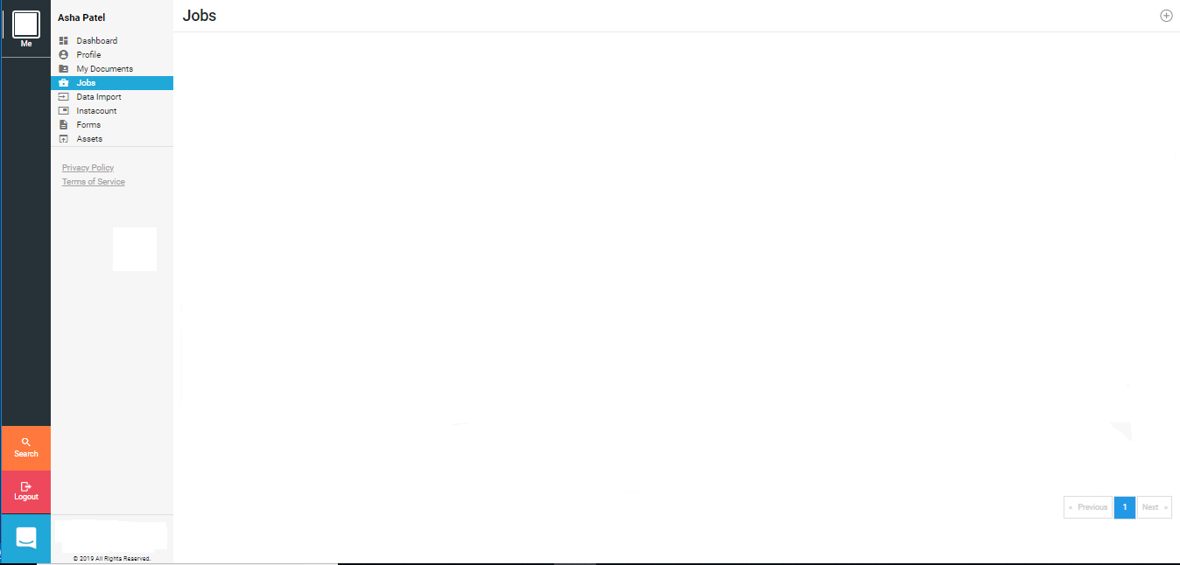
User Interface For Create Job Module (1)

Slide 13
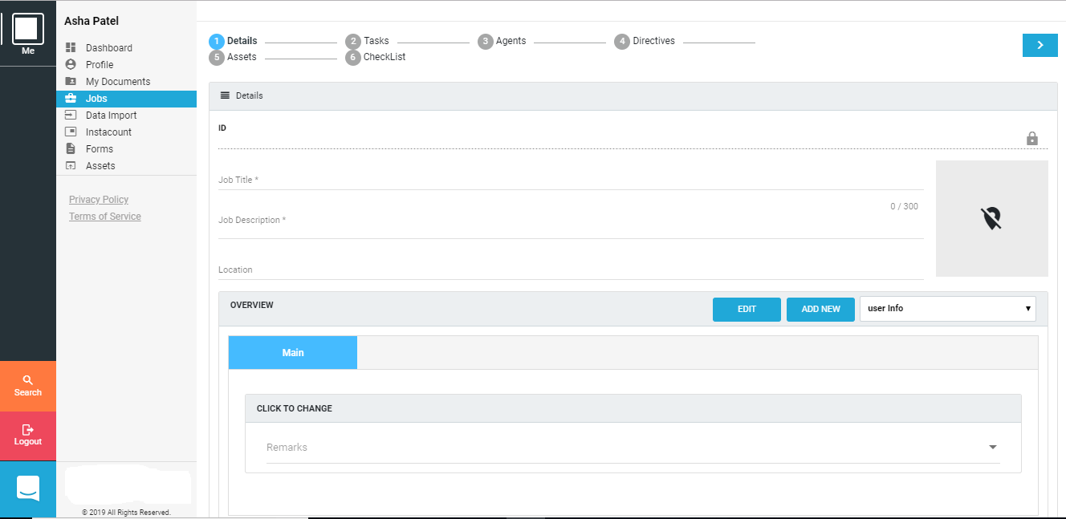
UI (2)

Slide 14
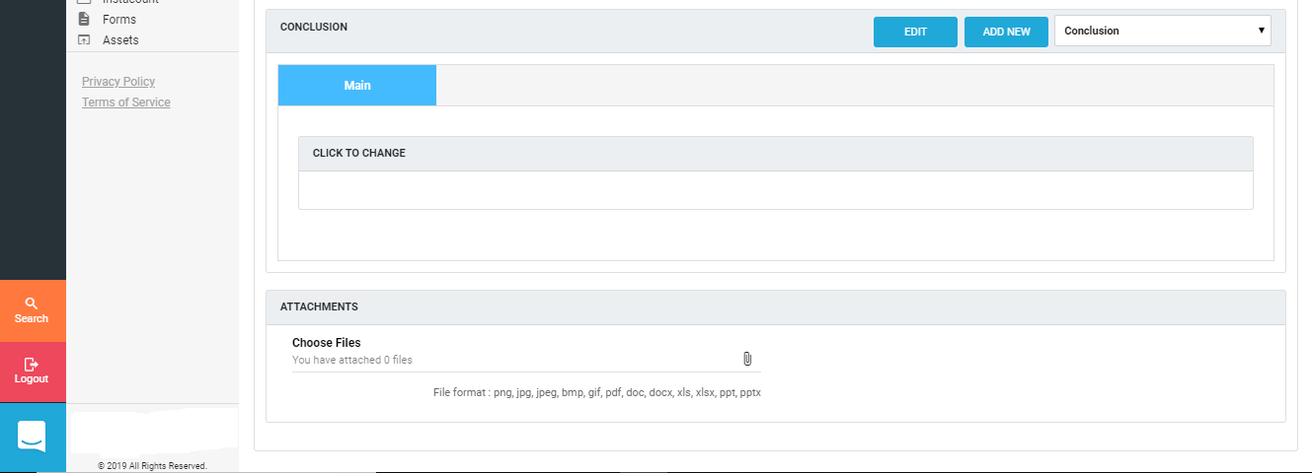
UI (3)

Slide 15
Create Form Module
Three type of forms:
1. general form
Used to add basic task information such as driver details, special instruction, total units, unite details etc.
2. overview form
Used in overview part of create job module.
3. conclusion form
Used in conclusion part of create job module.

Slide 16
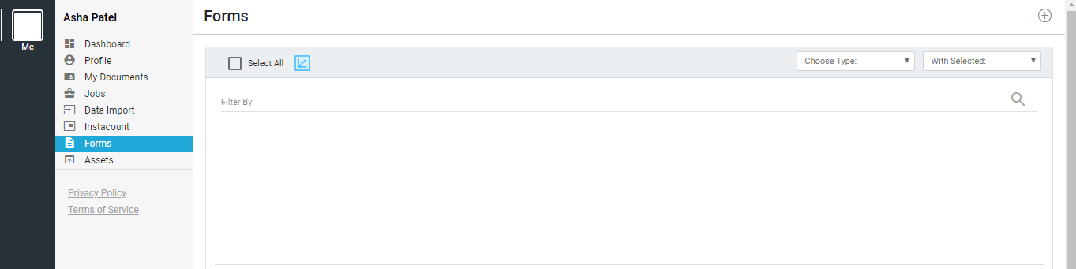
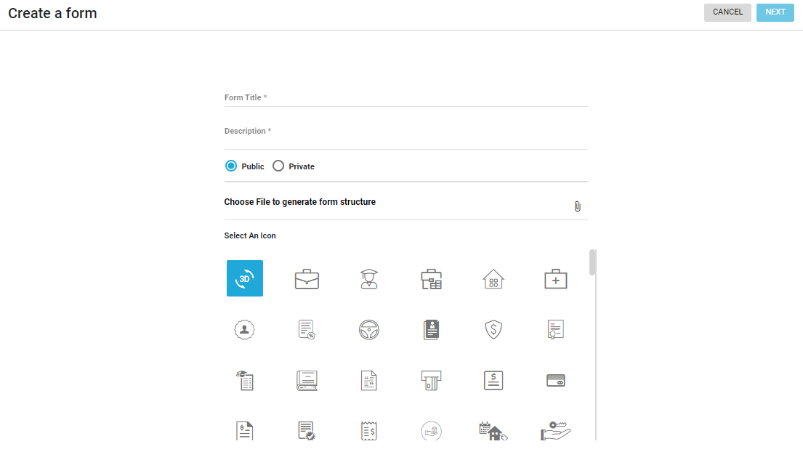
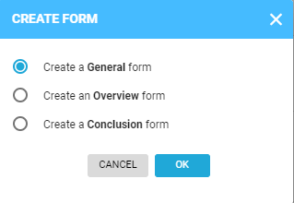
Create Form

Slide 17
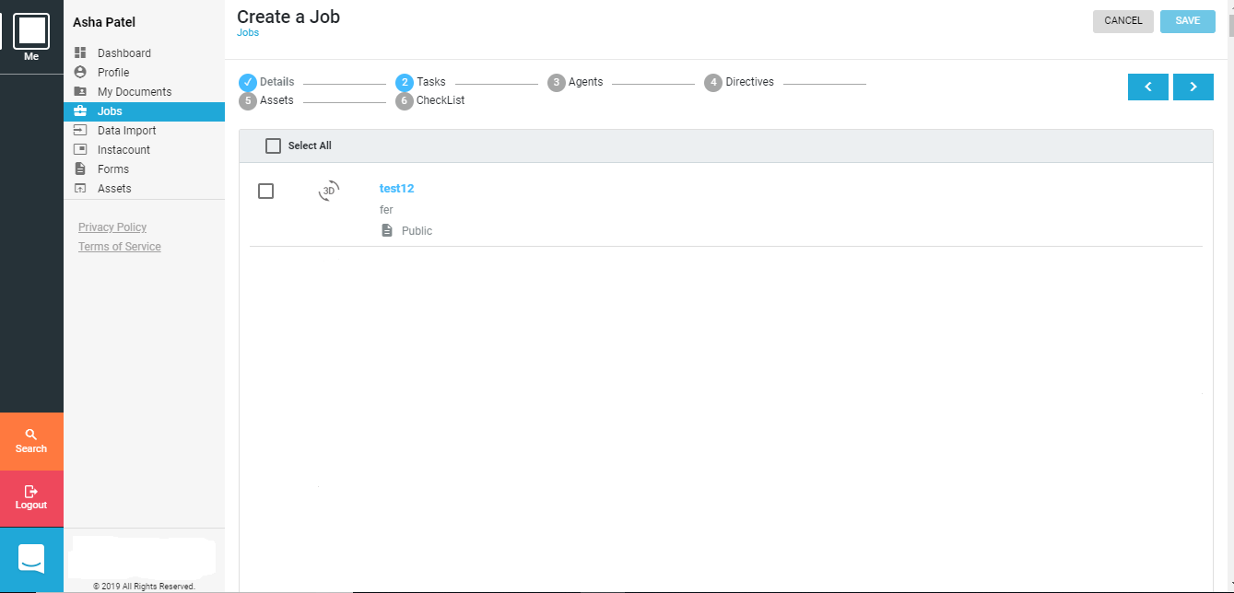
UI (4)

Slide 18
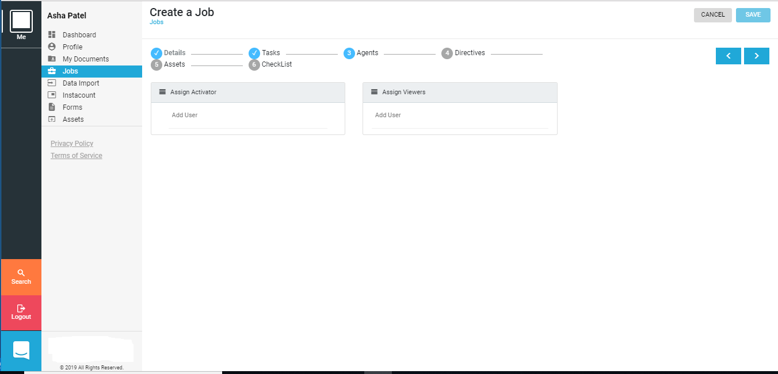
UI (5)

Slide 19
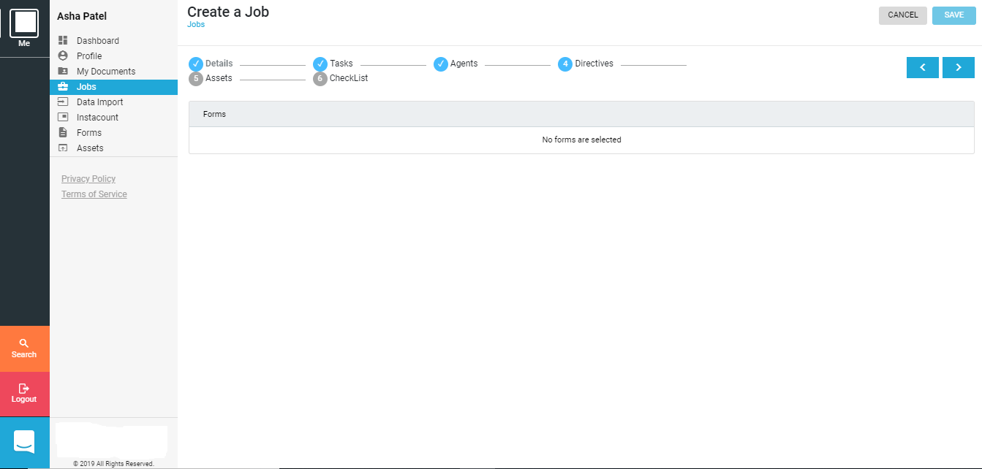
UI (6)

Slide 20
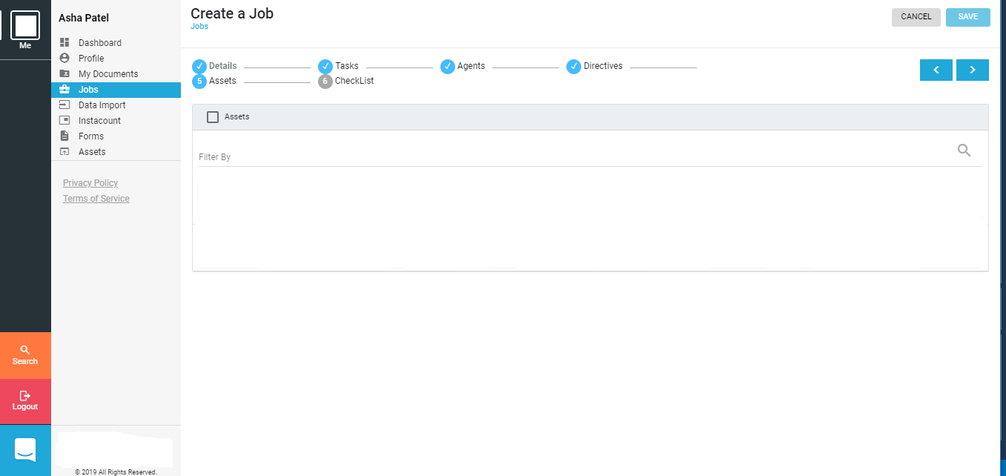
UI (7)

Slide 21
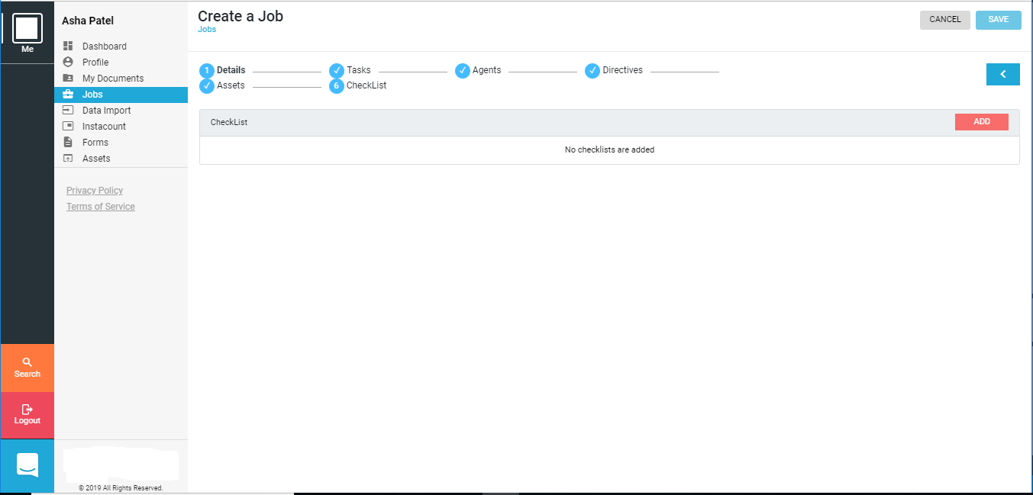
UI (8)

Slide 22
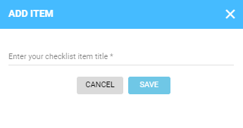
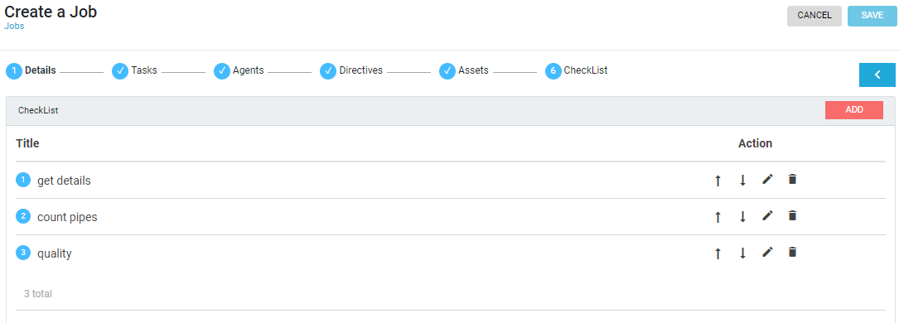
UI (9)

Slide 23
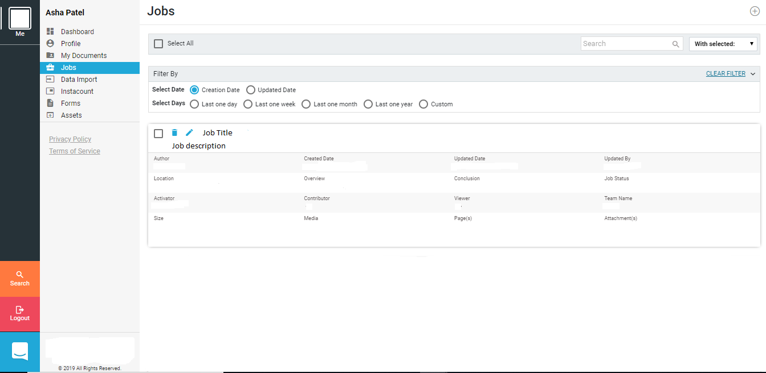
Jobs Overview
After successful creation of job, it’s basic overview will provided as given below.

Slide 24
REFERENCES:
https://www.mindtools.com/pages/article/newPPM_77.htm
https://www.glowtouch.com/business-analysis-process-flow
http://learn.promact.com/courses
https://angular.io
https://www.w3schools.com/booTsTrap/default.asp

Slide 25
Thank you…

